Slide 1
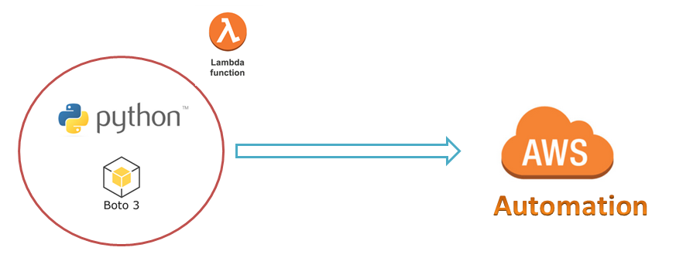
AWS Automation
with
boto3 of Python and Lambda Functions
Verifying Boto3 Environment Setup on Windows and Linux Servers to Work with AWS Services
Loop control statements or commands
(break and continue)
Learn how to automate AWS common tasks using boto3 and Lambda

Slide 2

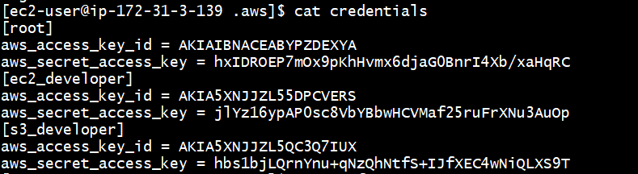
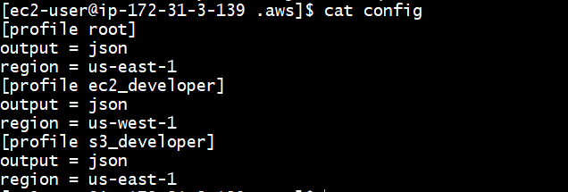
Verifying Boto3 Environment setup:
Our Environment setup is:
Python3.7.4, boto3 and awscli
Loop control statements or commands
(break and continue)
Learn how to automate AWS common tasks using boto3 and Lambda

Slide 3
Thank you

